Slide 1
UFC Dataset
Model | Class | F1 Score (marco)
1. Decision Tree | Blue | 0.432
 | Red | 0.761
 | Total | 0.596
2. Neural Network | Blue | 0.411
 | Red | 0.782
 | Total | 0.597
3. Boosting | Blue | 0.554
 | Red | 0.682
 | Total | 0.618
4. SVM | Blue | 0.567
 | Red | 0.675
 | Total | 0.621
5. KNN | Blue | 0.369
 | Red | 0.727
 | Total | 0.548
Wine Dataset
Model | Class | F1 Score (weighted)
1. Decision Tree | A | 0.913
 | B | 0.905
 | C | 0.893
 | Total | 0.904
2. Neural Network | A | 0.926
 | B | 0.934
 | C | 0.932
 | Total | 0.931
3. Boosting | A | 0.933
 | B | 0.939
 | C | 0.931
 | Total | 0.935
4. SVM | A | 0.933
 | B | 0.940
 | C | 0.930
 | Total | 0.935
5. KNN | A | 0.933
 | B | 0.931
 | C | 0.919
 | Total | 0.928

Slide 2
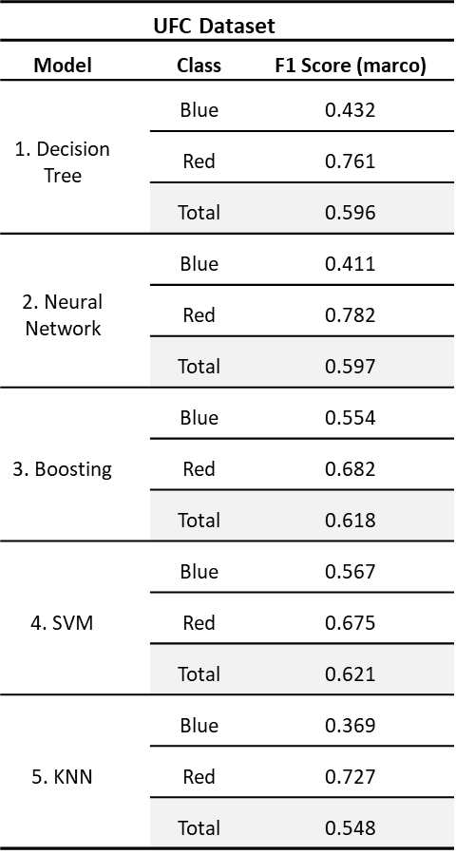
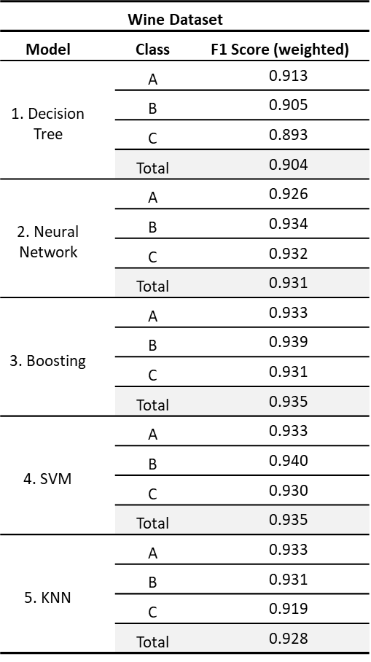

Slide 3



